Slide 1
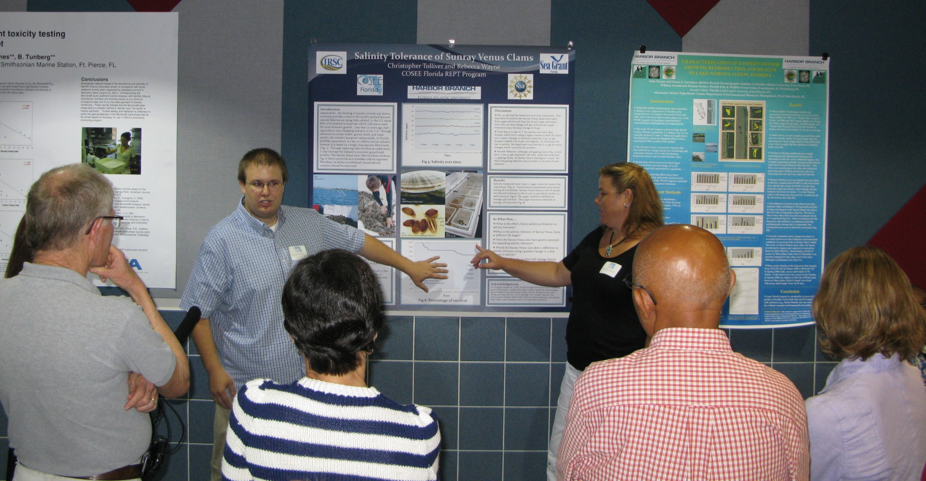
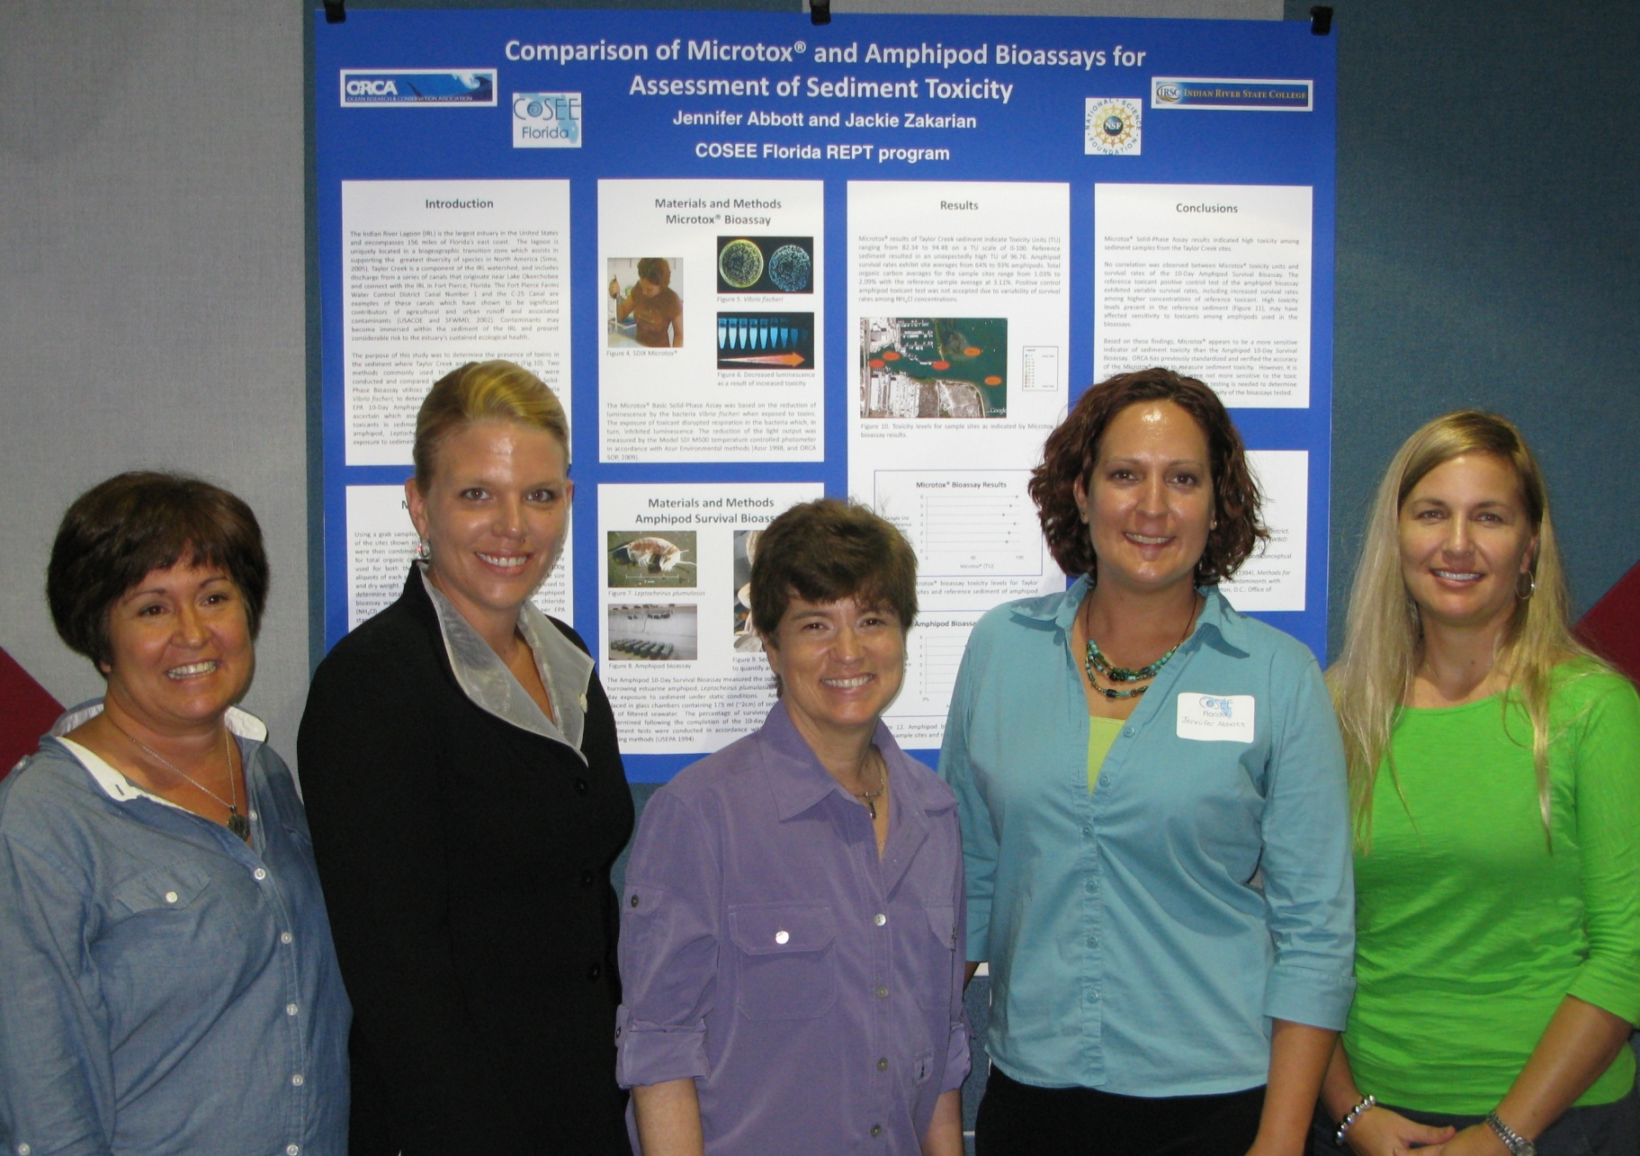
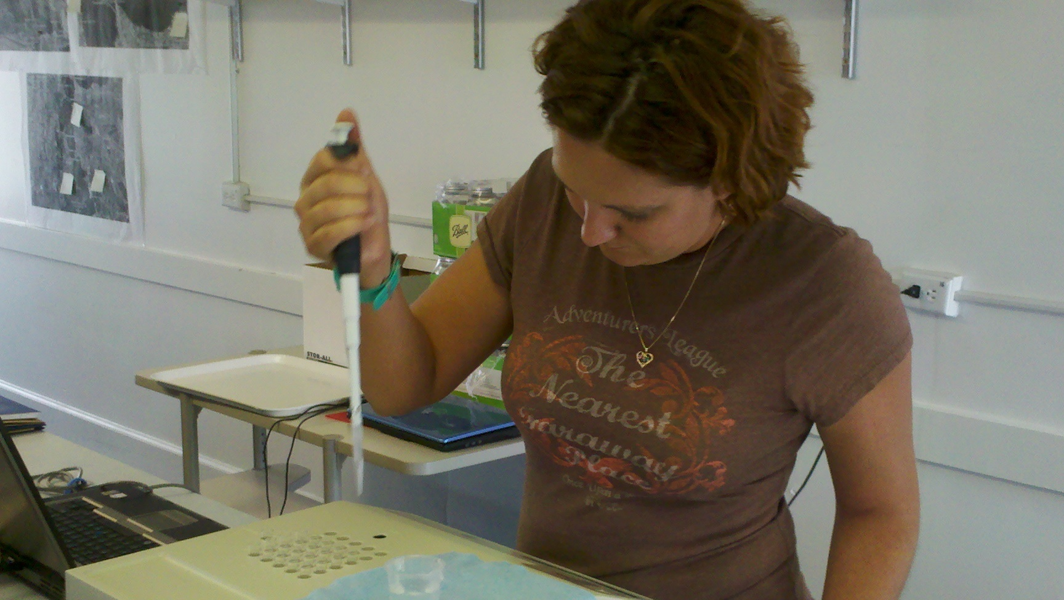
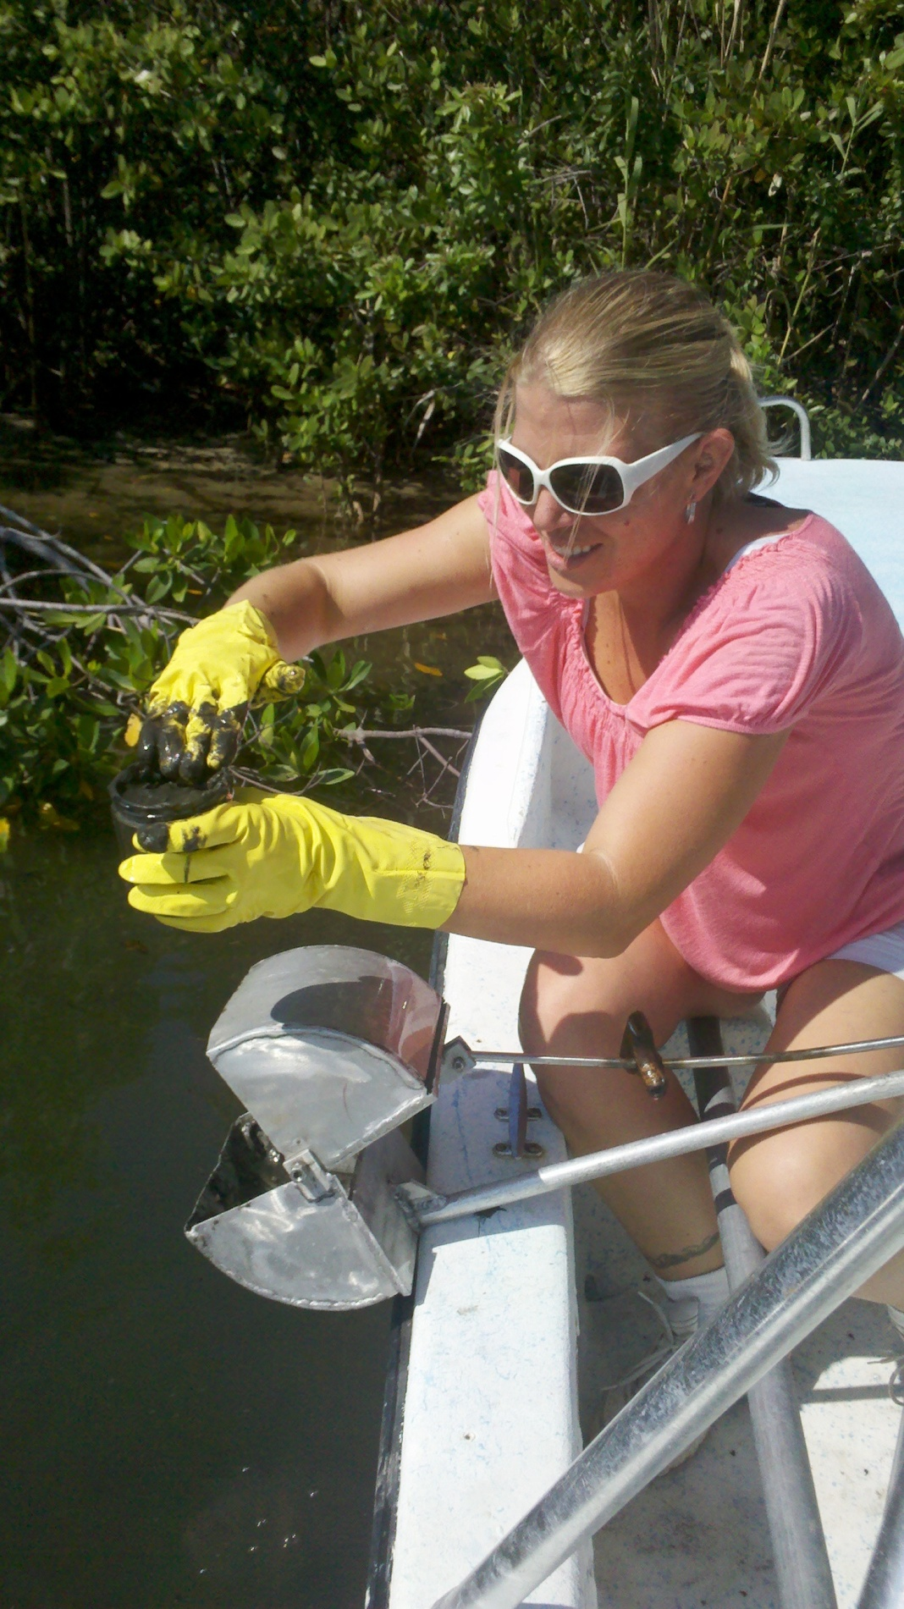
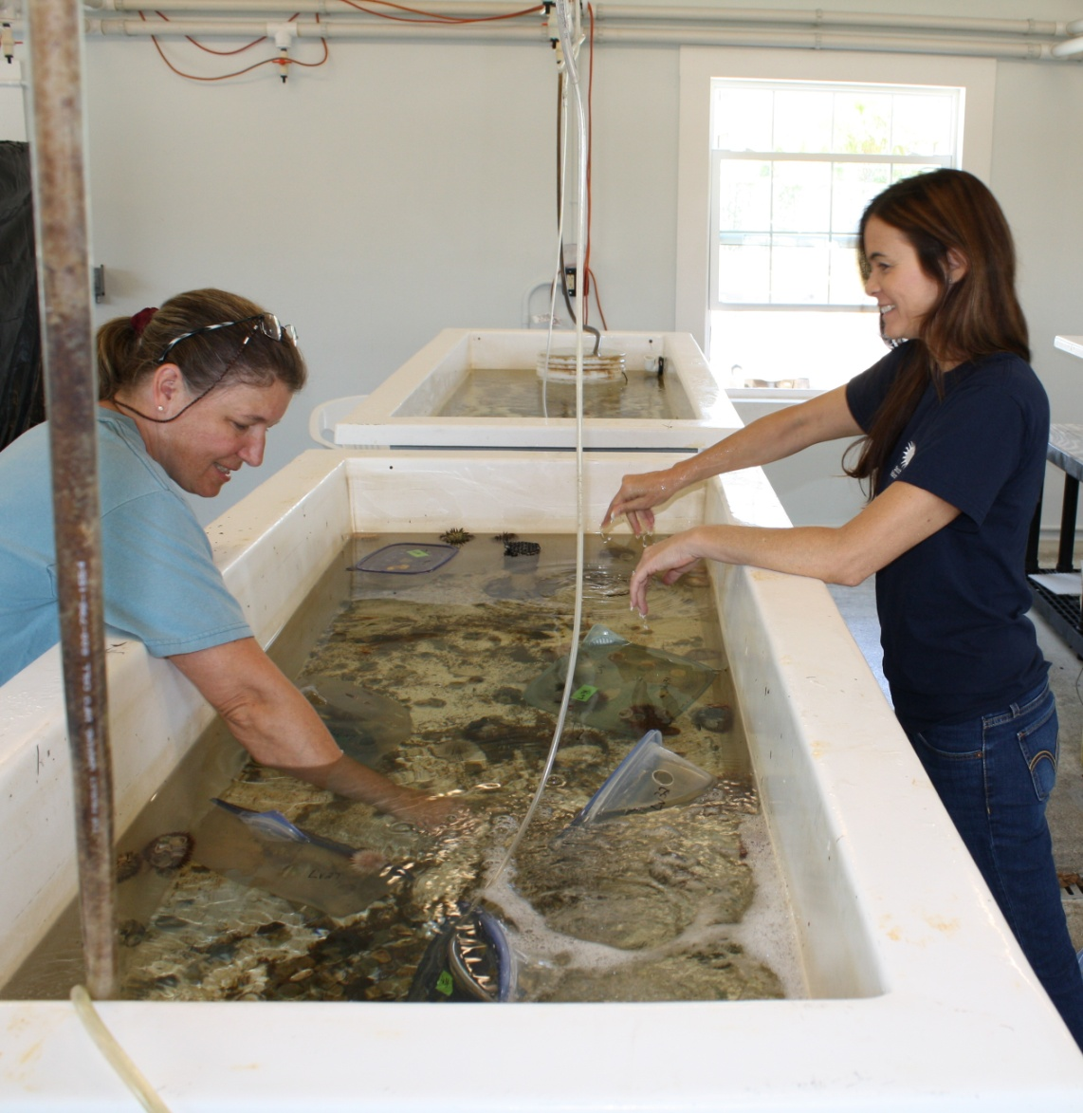
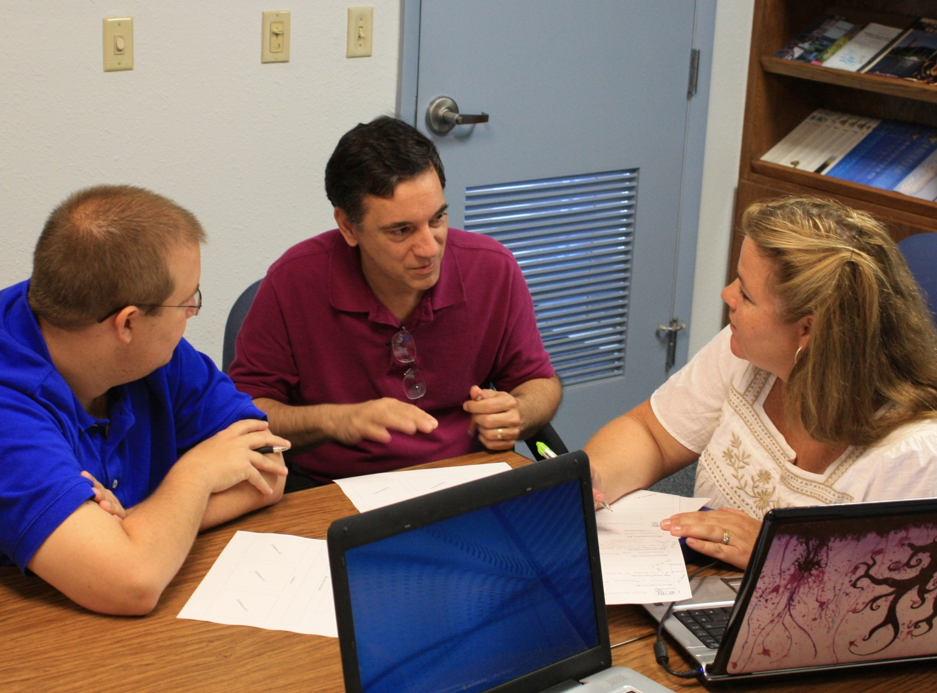
Connecting Ocean Scientists with Future Educators COSEE Florida’s Research Experience for Pre-Service Teachers Brenda Cetrulo, Jennifer Capers and Sue Cook Indian River State College, 3209 Virginia Avenue, Ft. Pierce, FL 34981
Program Overview and Goals:
Modeled after NSF’s Research Experiences for Undergraduates program, COSEE Florida’s Research Experience for Pre-Service Teachers (REPT) project is an educationally valuable capstone element within the Bachelor’s Degree in Middle Grades Science Education with a Concentration in Ocean Science at Indian River State College (IRSC). In summer 2011, junior and senior level science education majors conducted research with mentors from three local marine research organizations, produced a scientific poster and crafted an educational multi-media presentation.
Program goals for 2011 interns:
To gain valuable experience doing authentic science
To increase understanding of and enthusiasm for scientific research
To learn how to identify strategies, resources and tools for bringing the research experience into their future classrooms
Program goals for 2011 mentor teams:
To provide operationally feasible and well supervised opportunities for interns to do authentic science and gain a better understanding of what ‘real world’ scientists do
To gain experience in communicating scientific concepts in everyday language
To develop greater appreciation for middle school science teachers and teaching
Evaluation
The Study Group (TSG), COSEE Florida’s external evaluator, conducted personal interviews of the ocean scientist mentor teams and interns in fall 2011. TSG reported the following positive outcomes:
Benefits for Ocean Scientists:
The realization that working with pre-service teachers is a way to influence and improve science education.
The opportunity to “see science” from the teacher’s perspective and better understand the relevance of their research to the public.
Greater appreciation of middle school science teachers and teaching.
Benefits for Interns:
Valuable experience doing “real science” in a “real setting”.
Increased understanding of and enthusiasm for scientific research.
Access to a variety of resources and strategies that apply the REPT research experience to the middle school classroom.
Summer 2011 Project Descriptions
Ocean Research and Conservation Association
Interns analyzed sediment toxicity in the Indian River Lagoon, Florida. Two assays were compared: the EPA 10-Day Amphipod Survival Bioassay, and the Microtox® Basic Solid-Phase Bioassay. The Microtox Bioassay, which utilizes the luminescent properties of the bacteria Vibrio fischeri as an indicator of toxicity, was more sensitive.
Smithsonian Marine Station at Fort Pierce
Interns monitored the progression of the cyanobacterial bloom on a seagrass flat adjacent to Little Jim Island in the IRL and assessed its impact. They conducted an herbivore feeding assay and an anti-microbial assay to test for possible effects on seagrass organisms.
Harbor Branch Oceanographic Institution
Working in the aquaculture division, interns measured survival rates of a new clam culture candidate, Macrocallista nimbosa, under varying salinity conditions.
Future Plans
Based on input from mentors and TSG’s report, our program was an excellent start-up. However, to make ‘the best even better’ we are adding two elements to our model.
A mentor workshop hosted by IRSC. This workshop will introduce potential mentors to the expertise of seasoned mentors, provide examples of feasible projects, and explore strategies to ensure a more meaningful experience for the mentors.
Collaborative follow-up activities. To ensure continued interaction, we will invite interns and mentors to COSEE events, provide volunteer opportunities for interns with the research institutions, help schedule classroom visitations and presentations by the ocean scientist, and explore other strategies. As an example of continued interaction, two program graduates presented research posters at the Indian River Lagoon Symposium on February 9, 2012.
REPT Core Elements
The REPT program has 11 core elements (Table 1) important to the overall success of the program. These should continue to guide this model program both at IRSC and in future iterations of the model by Florida State Colleges.
Table 1. Core elements of the COSEE Florida REPT program.
Ocean Scientists & Interns | Ocean Scientists | Interns
7 week commitment | Supervise a finite and relevant research project for two students | Actively engage in “real” science
20+ hours of research per week in lab/field | Provide a mentor team of 2-3 staff | Participate in 5 hours/week of support meetings
Produce scientific research poster and Florida Aquatic Science Hero (FLASH) video | Host a 1.5 hour lab tour | Learn strategies to apply the experience to classroom teaching
Attend a 1.5 hour science symposium |  | Work in pairs
Intern Educational Products
In addition to contributing to the research team’s poster, each intern designed and produced a video that described how his/her research experience refuted a common misconception in science. Themes explored included:
Scientists are not boring lab rats.
Science involves creativity.
Science experiments do not always answer the questions
posed.
Acknowledgements
This poster describes work supported by the National Science Foundation under Grant No. OCE1039107 to Indian River State College for “COSEE Florida: Water as Habitat”.
Educational facilities and administrative staff support were provided by Indian River State College. The Ocean Research and Conservation Association, the Smithsonian Marine Station at Fort Pierce and Harbor Branch Oceanographic Institute of Florida Atlantic University provided research facilities and support for mentor research teams.

